Slide 1

AIRPLANE CARSHES ANALYSIS PowerBI Project
- Raj Jadhav

Slide 2

PROBLEM STATEMENT
This Internship project focuses on conducting a comprehensive analysis of airplane crashes and fatlites spanning from 19830 to 2023. The dataset contains crucial information such as crash dates, locations,operators,filght details,aircraft types, and fatality statistics. The goal is to leverage Power BI for Interactive visulaizations and In-depth insights to understand patterns, contributing factors and trends in aviation incidents.

Slide 3
OVERVIEW
Dataset Description
Data Loading
Data Transforming
Temporal Analysis
Geospatial Analysis
Operator Performance
Aircraft Analysis
Fatality Trends
Route Analysis
Final Dashboard
Recommedation

Slide 4

DATASET DESCRITPION
1. Date: Date of the airplane crash.
2. Time: Time of the airplane crash.
3. Location: Location where the airplane crash occurred.
4. Operator: Operator or airline involved in the incident.
5. Flight #: Flight number associated with the incident.
6. Route: Planned route of the flight.
7. AC Type: Aircraft type involved in the crash.
8. Registration: Registration details of the aircraft.
9. cn/ln: Construction or serial number of the aircraft.
10. Aboard: Total number of individuals aboard the aircraft.
11. Aboard Passengers: Number of passengers aboard the aircraft.
12. Aboard Crew: Number of crew members aboard the aircraft.
13. Fatalities: Total fatalities in the incident.
14. Fatalities Passengers: Number of passenger fatalities.
15. Fatalities Crew: Number of crew member fatalities.
16. Ground: Casualties on the ground, if any.
17. Summary: Brief summary or description of the incident.

Slide 5
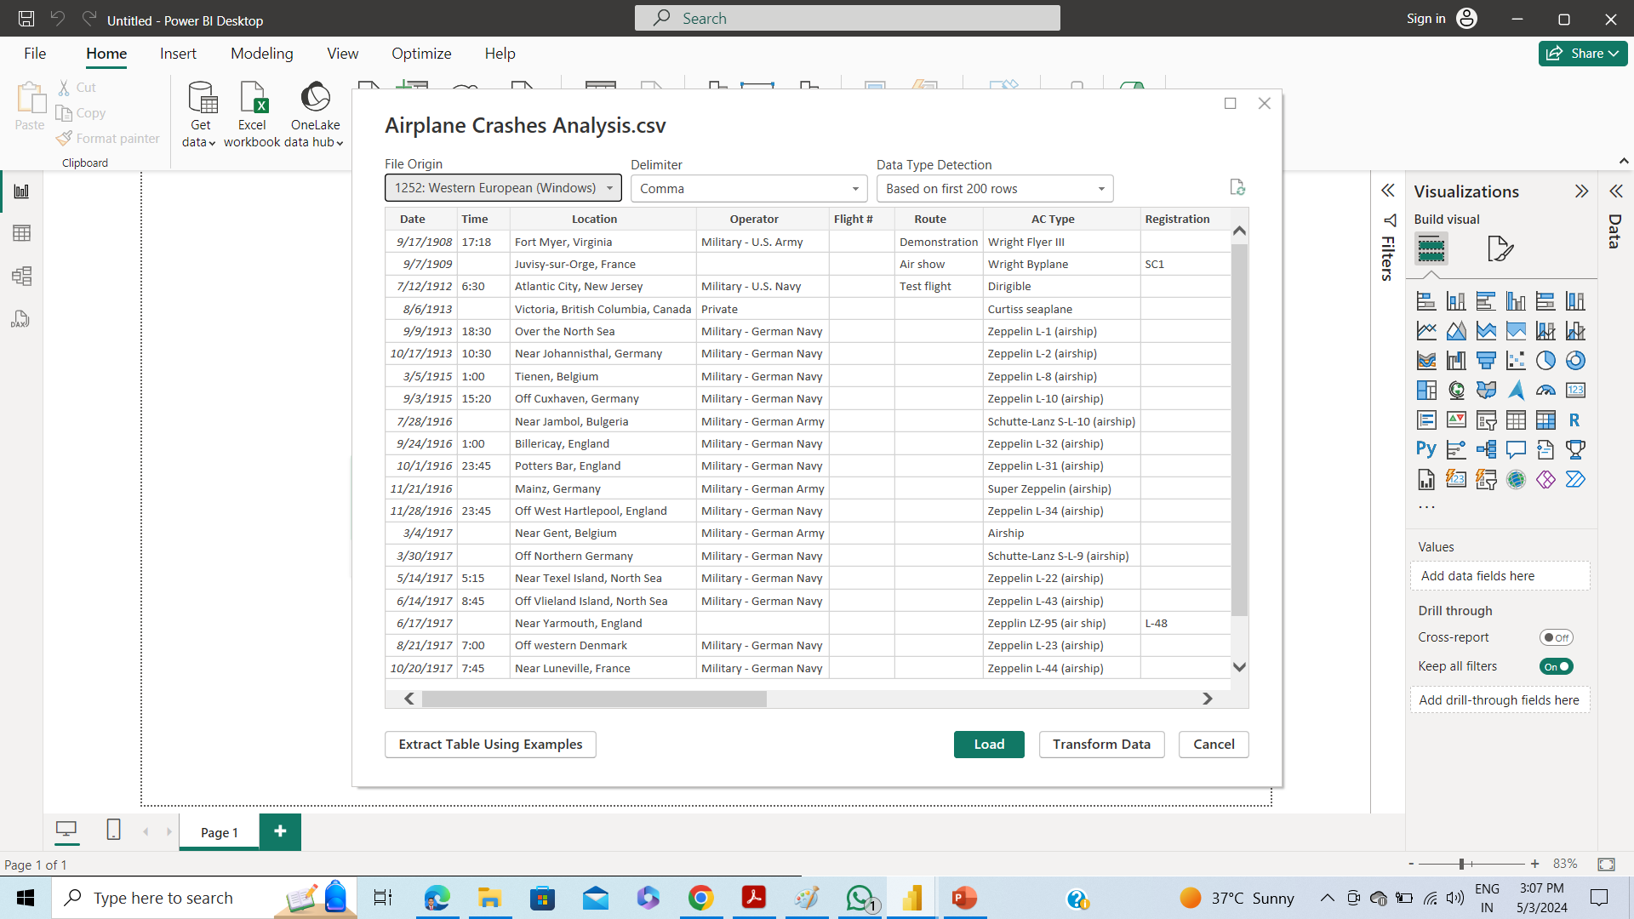

DATA LOADING

Slide 6
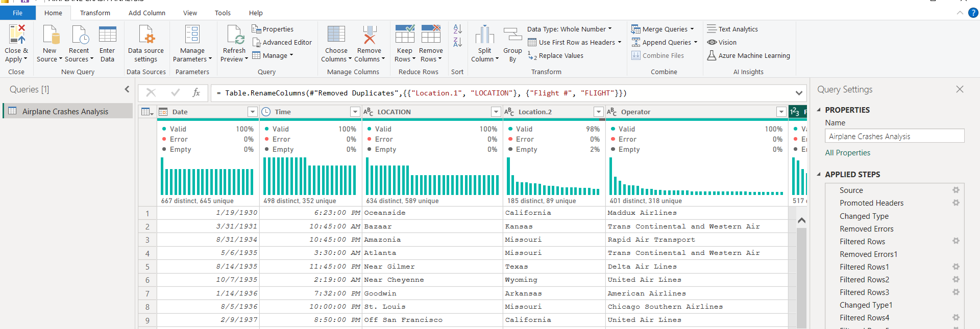
DATA TRANSFORMING
CHANGED DATA TYPE
REMOVED EMPTY ROWS
FILTERED ROWS
REPLACED MISSING VALUES
REMOVED UNNECESSARY COLUMN

Slide 7

TEMPORAL ANALYSIS
Explored termporal trends in airplane crashed over the year
Chart Type : used line chart
Conclusion : The highest number of fatalities in 2358 in the year 1972

Slide 8

GEOSPATIAL ANALYSIS
Visualized crash location on a map to identify hotspots
Chart type : used Map
Conclusion : The highest number of fatalities is 761 in the location Tenerife, Canary Islands.

Slide 9

OPERATOR PERFORMANCE
Evaluated the safety records of different operators and airlines
Chart Type: Used clustered Bar Chart
Conclusion : The highest number of fatalities is 7879 caused by operator Aerpflot.

Slide 10

AIRCRAFT ANALYSIS
Analysed the involvement of specific aircraft types in incidents
Chart Type: Used Donut chart
Conclusion : The highest number of fatalites is 246 caused by Aircraft Type Yakovlew YAK-42D.

Slide 11

AIRCRAFT ANALYSIS
Examine the relationship between aircraft registration and crash occurrences.
Chart type : Clustered Bar chart
Conclusion : The highest number of fatalities is 583 caused by Aircraft having Registration details N736PA/PH-BUF

Slide 12
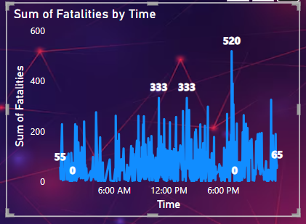
FATALITY TRENDS
Chart Type : Used Line chart
Conclusion : The highest number of fatalities (831 passengers and 152 crew) occurred at 2.00 PM.

Slide 13
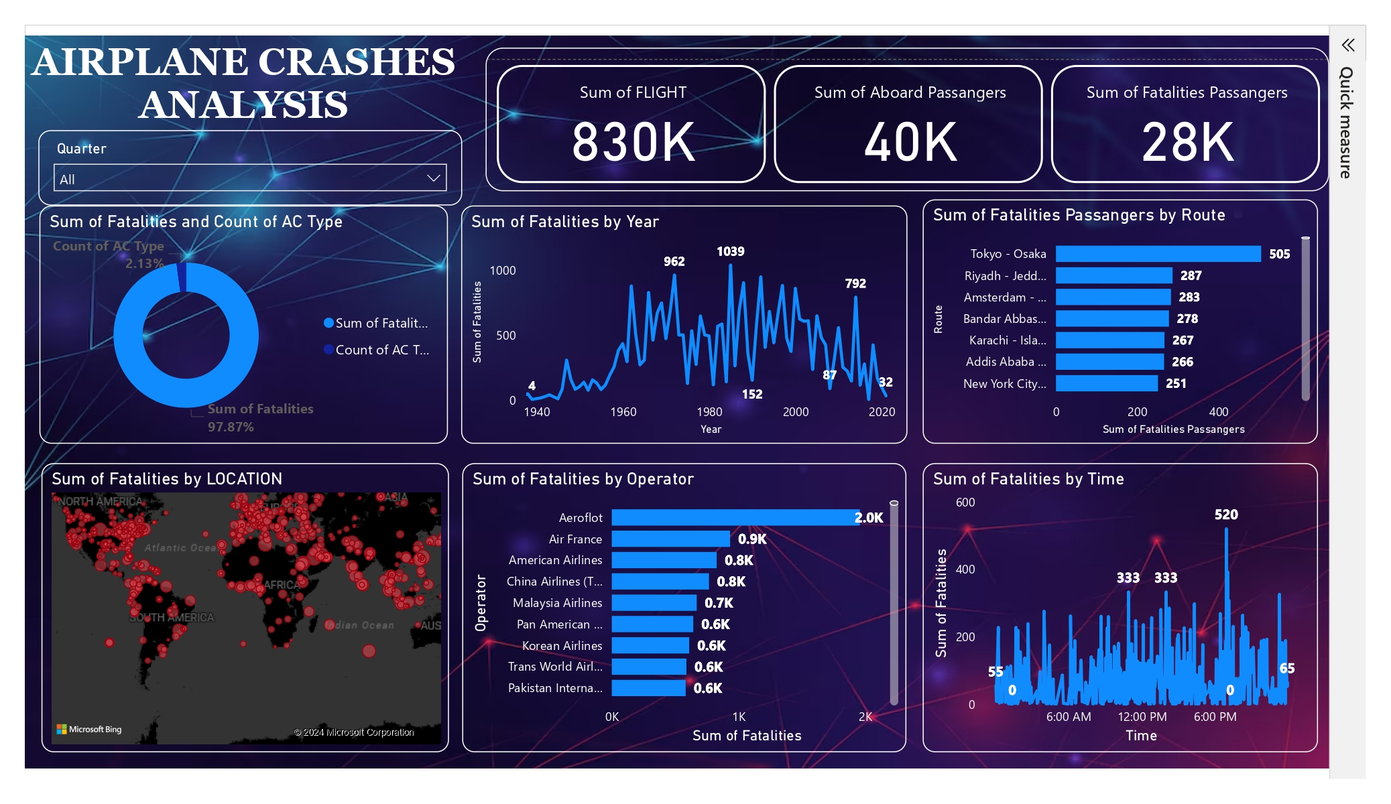
FINAL DASHBOARD

Slide 14
RECOMMEDATION
Highest fatalities occurred in 1972, Indicating saftery issues. Analyze past incidents thoroughly to implement necessary safety measures and prevent recurrence.
Siginifant fatalities associated with Tenerife, Canary Islands, and Aeroflot operator. Collaborate with Aeroflot to enhance saftery protocols and conduct route-specific risk assements for Tenerife-Las Palmas to mitigate future risks.
Certain aircraft types and registrations linked to high fatlities. Perform comprehensive safety reviews and maintemance checks for these aircraft to ensure airworthiness and prevent accidents.

Slide 15

Thank You
-Raj Jadhav

